Slide 1

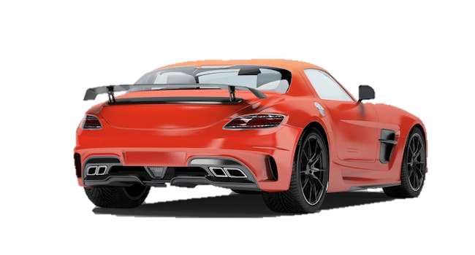
THE CAPSTONE PROJECT- 2 (Visualization) Title : Forza Horizon Cars Tool : Power BI Batch : PGA-20 Under the Guidance of Arun Upadhyay Submitted by C ChandraMouli

Slide 2
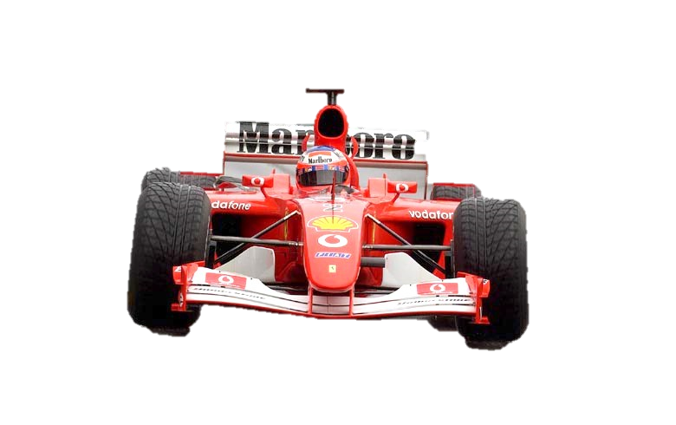
Contents
1. Introduction 2. Data Description 3. Pre-Processing 4. Ques to be answered 5. Insights 6. Conclusion

Slide 3
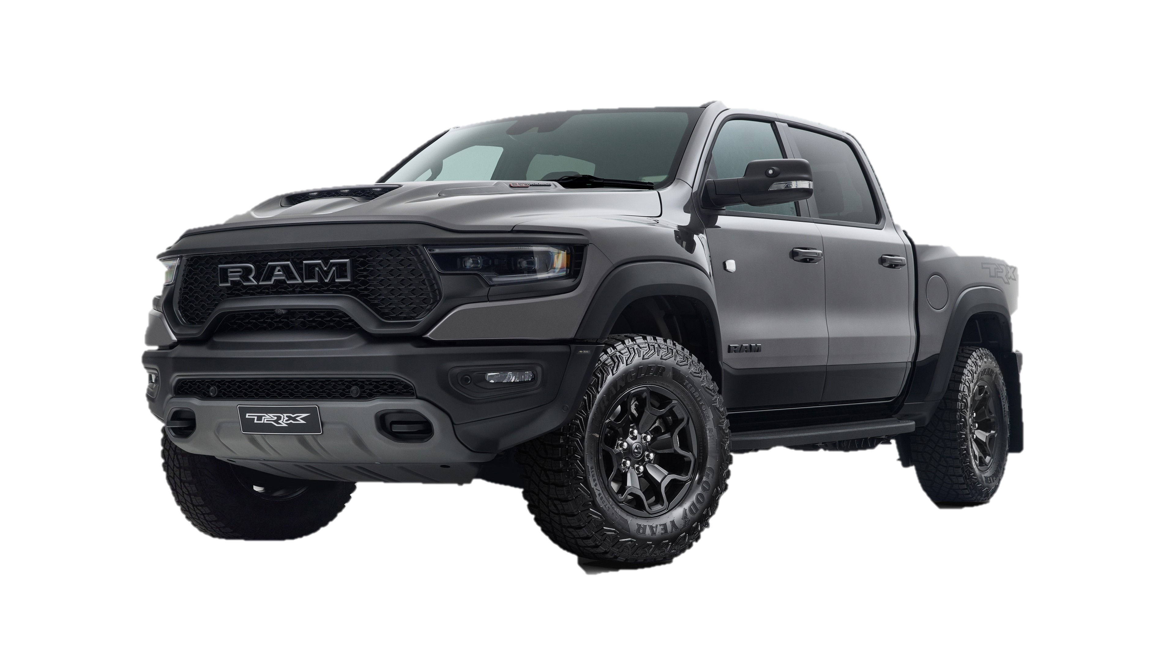
Introduction:
Forza Horizon is a famous open world car game that is developed by Playground Games and published by Xbox Game Studios.
The game gives the player freedom to navigate all the places in different cars according to the players will.
It also consists of events which winner is gifted with new exotic cars.
The analysis is based on the data provided by the data that is acquired from the kaggle

Slide 4
Data description:
Forza Horizon 5 is a 2021 racing video game developed by Playground Games and published by Xbox Game Studios. The twelfth main instalment of the Forza series, the game is set in a fictionalized representation of Mexico. This dataset is a collection of cars that we can find and buy in the game. The dataset contains various features such as car speed, ratings, power etc.
Columns:
Car Image, name of the model, model type, in game price, car source, stock specs, stock rating, Dive type, speed, handling.

Slide 5
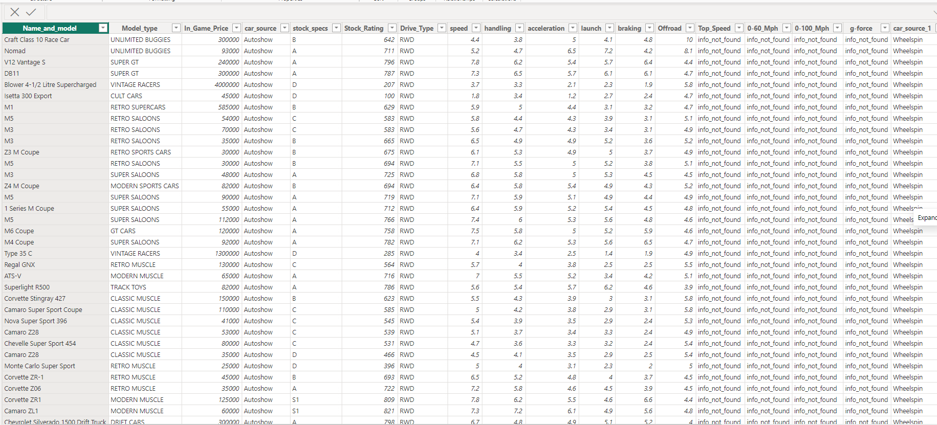
Tabular data :

Slide 6
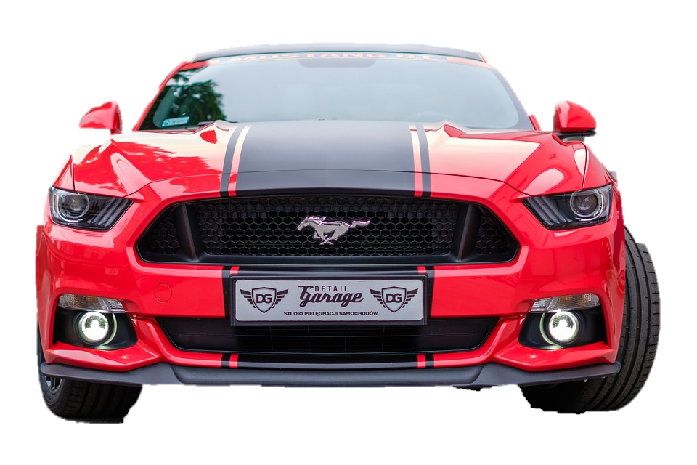
Pre Processing steps
The name of the company is derived from the model name
Besides company the data dosnt have any requirements for pre processing steps.
The data is clean to proceed with the further data analysis steps

Slide 7
Questions
Which brand produces most cars
Price differences between the cars and in between the types of cars
Min and max acceleration and handling and other performance matrixs of the car
Which is the best type of car
Which model are the most produced cars.

Slide 8
Insights
Among 539 cars models that present in game Ford dominated with 9 % of its wide variety of models followed by Ferrari ,Porsche, BMW, with5.9,4.7,4.2 % respectively.
The most performance oriented cars is from Ferrari, zenvo, willis, Koenigsegg, Lamborghini, bmw, Porsche, the horse power if nearly 900 hp min.
What is the average price per company and with modles.
Price changes for stock spec and tuned spec cars

Slide 9
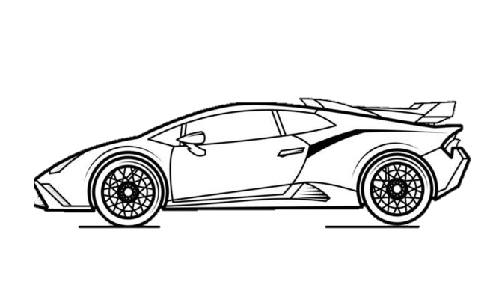
Thank You…..

